Slide 1
The American Academy of Physical Medicine and Rehabilitation
Residency Resource Kit
PGY 2 - 4

Slide 2
Who is AAPM&R?
The American Academy of Physical Medicine and Rehabilitation (AAPM&R) is the national organization of physiatrists representing more than 8,000 members.

Slide 3
Our Mission: AAPM&R serves its member physicians by advancing the specialty of physical medicine and rehabilitation, promoting excellence in physiatric practice, and advocating on public policy issues related to persons with disabling conditions.
Our Vision: AAPM&R will be the leader in assisting PM&R physicians to acquire the continuing education, practice knowledge, leadership skills, and research findings needed to provide quality patient care, and to represent the best interests of patients with, or at risk for, temporary or permanent disabilities.

Slide 4
AAPM&R is a Resource for All Things PM&R

Slide 5
Notes:
PM&R Knowledge NOW
All the content created by physiatrists for physiatrists is on the enhanced PM&R Knowledge NOW®. This is an evolving, dynamic online resource that highlights the breadth and depth of clinical topics in the specialty of PM&R. As the specialty's go-to resource, PM&R Knowledge NOW® offers 300+ clinical topics for you to explore. (www.pmrknowledgenow.org)

Slide 6
Notes:
acadeME®
mē® (www.me.aapmr.org) is AAPM&R's all-inclusive online education platform that is designed to provide a unique experience for each user. It allows you to view your personal transcript, access all of the educational activities you have registered for, and browse educational activities that are recommended specifically for you, including CME activities, case studies, online courses, podcasts, and slide lectures. (www.me.academe.org)

Slide 7
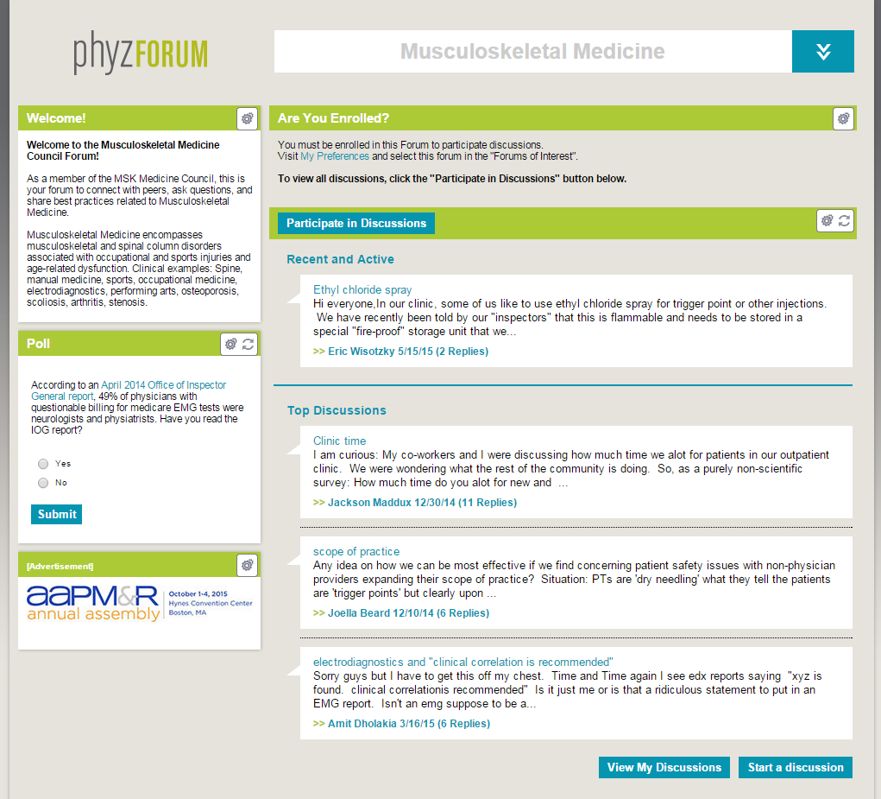
Notes:
PhyzForum
PhyzForum is your Academy’s online peer network that connects members 24 hours a day, 7 days a week. You must be a member and logged in to access PhyzForum. Members can collaborate with each other to share insights, expertise, and resources. (www.phyzforum.org)
Networking: Network, collaborate, and exchange best practices with physiatrists who share your clinical interests on the Academy’s online peer network, PhyzForum (www.phyzforum.org).

Slide 8
Notes:
Member Councils:
Communities of physiatrists based on clinical focus – free for members. Five Member Councils are currently available.

Slide 9
Free Member Publications

Slide 10
Editorials
Focused reviews
Point-counterpoint debates
Comprehensive reviews
Original research
Case studies
Ethical legal discussions
Notes:
PM&R, the Academy’s scientific journal, offers clinically relevant and evidence-based research and review information.

Slide 11
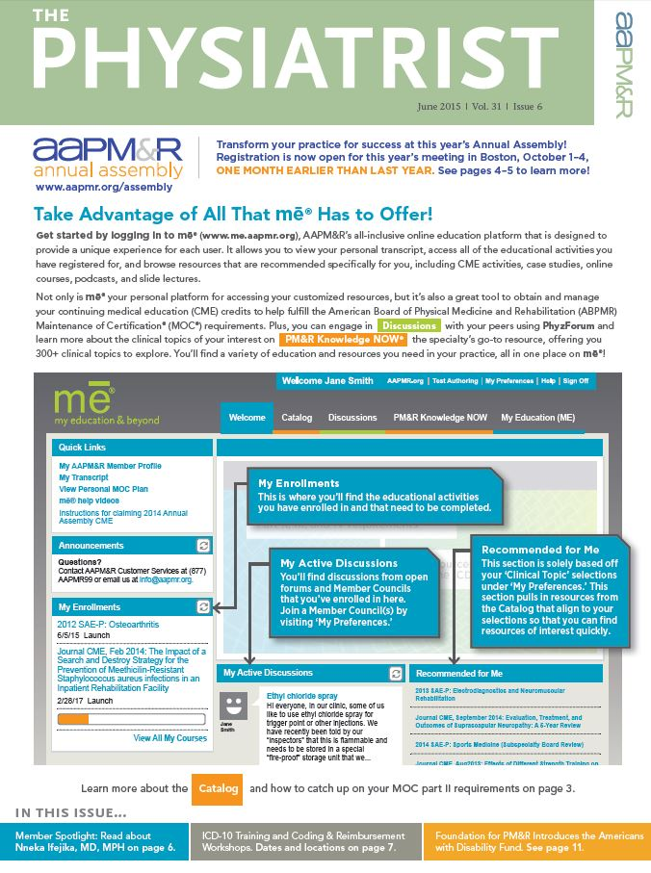
Notes:
The Physiatrist updates you each month on Academy activities and programs, legislative actions, practice and socioeconomic issues, educational courses, and specialty developments.

Slide 12
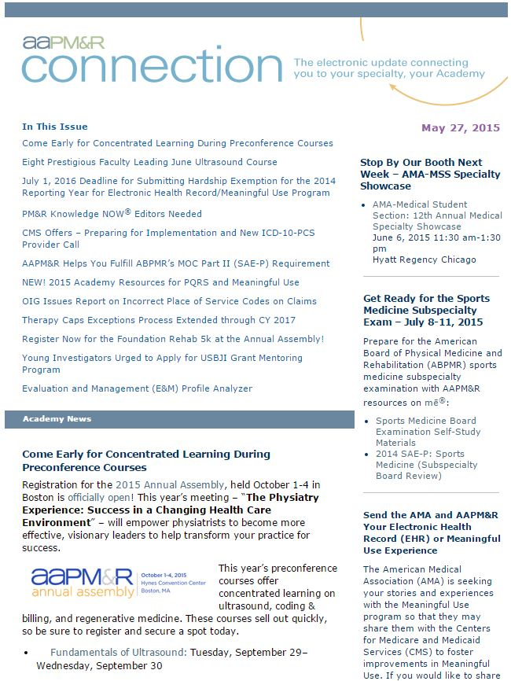
Notes:
AAPM&R’s bi-weekly e-newsletter, Connection, helps you stay current regarding events, Academy and specialty news, information on policy and legislation related to PM&R, and more.

Slide 13
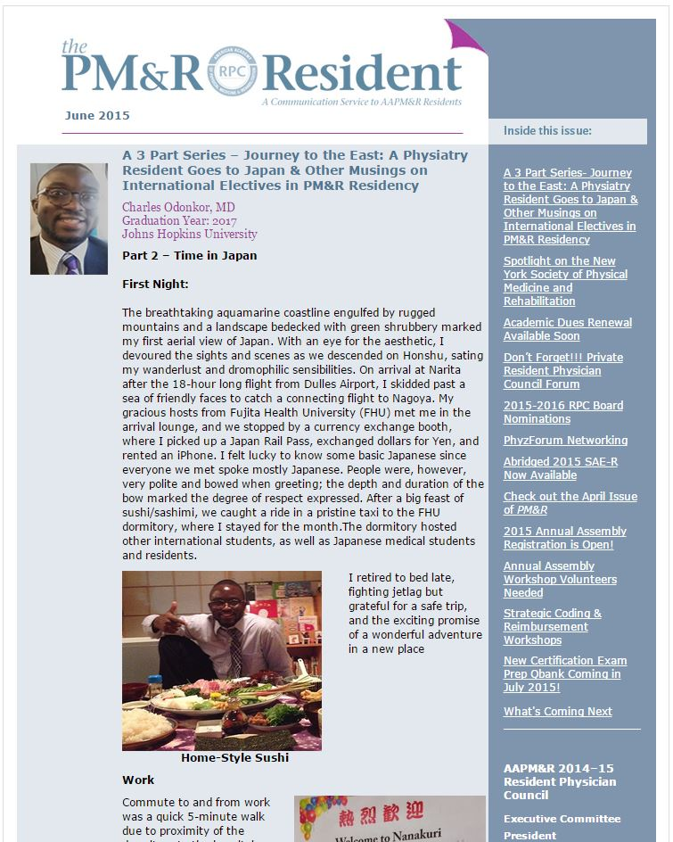
Notes:
The PM&R Resident is a monthly newsletter developed by residents for residents, and provides information to help Academy’s residents develop informed opinions on subjects that will affect their professional and, in some instances, their personal lives.

Slide 14
AAPM&R is a Mentor Throughout the Resident Experience
Notes:
Annual Assembly
Research Guidance
Post Residency Planning Advice
Networking

Slide 15
Notes:
Annual Assembly: Gain connections, advanced education, and more when you attend the Annual Assembly (www.aapmr.org/assembly).

Slide 16
Research Guidance:
Find PM&R research resources, including available awards and grants.
www.aapmr.org/career/residents/program
Post Residency Planning Advice: Created by your peers, find advice and resources to help you take the next step in your career.
www.aapmr.org/career/residents/career
Notes:
Research Guidance: Find PM&R research resources, including available awards and grants on www.aapmr.org/career/residents/program.
Post Residency Planning Advice: Created by your peers, find advice and resources on www.aapmr.org/career/residents/career to help you take the next step in your career.

Slide 17
AAPM&R Is A Résumé Builder
Here are just a few ways you can enhance your résumé by joining AAPM&R:
Apply to become a member of the elected Resident Physician Council (RPC) board, which focuses on developing and sustaining a strong resident community.
Apply to become a co-author for the PM&R Knowledge NOW®. It’s a great way to get published and recognized by your peers!
Volunteer to work the Annual Assembly workshops. Learn, participate, and save all in one experience.

Slide 18
AAPM&R is a Guide to the Next Stage in Your PM&R Career

Slide 19
Job Board:
JOB SEEKERS: Post resumes & search open positions
EMPLOYERS: Post open positions & search resumes
For more information (employers or job seekers), please visit www.aapmr.org or call (847) 737-6000 or email careerservices@aapmr.org.
Job Fair:
Wednesday, September 30, 2015
One day prior to the start of the 2015 AAPM&R Annual Assembly
Boston, MA
More than 100 employers in one location
Tremendous exposure and networking opportunities
Notes:
Physiatrists’ Online Job Board: AAPM&R is a member of the National Healthcare Career Network, an alliance of more than 170 trade and professional associations that serves job seekers searching for specialized health care careers. (www.aapmr.org)
Job Fair at the Annual Assembly: Take advantage of the opportunity to meet 100+ employers. Network with representatives from institutions who are hiring, and leave a lasting impression by meeting face-to-face. The 2015 Job Fair takes place September 30 in Boston, MA.

Slide 20
Notes:
ABPMR Maintenance of Certification (MOC): If you plan on becoming a board certified physiatrist, you’ll need to renew your certification every 10 years as required by ABPMR. The Academy can help you meet these requirements through acadeME, www.me.aapmr.org.

Slide 21
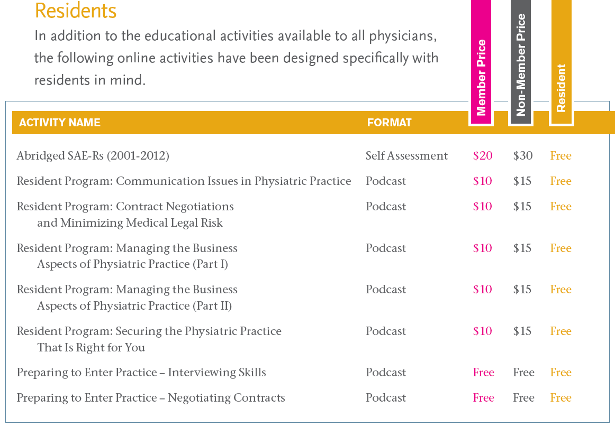
Board Preparation: Find Abridged Self Assessment Examination for Residents (SAE-R), Self Assessment Exam for Practitioners (SAE-P), and case studies all on acadeME, www.me.aapmr.org.
Practice Management Resources: Find resources to help you market the specialty or your practice, request proper reimbursement, stay updated on practice guidelines, and manage your practice of PM&R. (www.aapmr.org/practice)

Slide 22
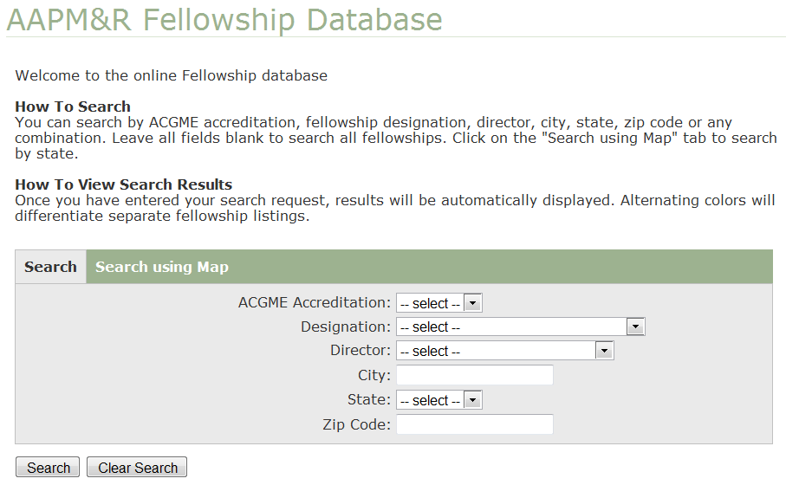
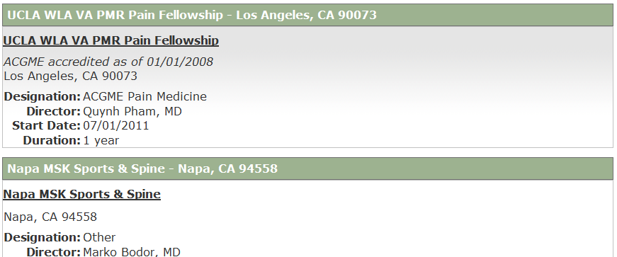
Fellowship Database: Find PM&R fellowship opportunities within the United States. (www.aapmr.org/fellowship)

Slide 23
AAPM&R is an Advocate for Physiatry

Slide 24
AAPM&R Is An Advocate for Physiatry
The Academy’s legislative, regulatory and grassroots’ advocacy activities and efforts are closely aligned with priority issues that affect the specialty of physiatry.
Find your voice in health care reform discussions by getting involved through the AAPM&R Advocacy Action Center.
Plus, receive up-to-date news regarding Medicare payment, Essential Health Benefits and other legislative and regulatory debates taking place in Washington, DC and State Legislatures.

Slide 25
AAPM&R is Your PM&R Community: Join today!
Cost to Join:
$75 (or find out from your program director if your residency program pays for Academy membership!)
How to Join:
Visit www.aapmr.org and type “join” into the search bar. Fill out the appropriate application and send it in today.
Note: Resident membership with the Academy is based on an academic calendar (July 1 – June 30).

